Slide 1
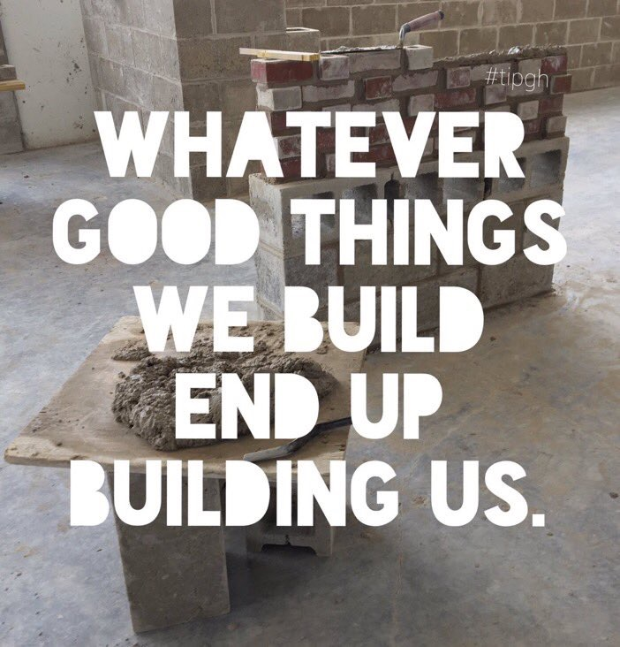

Slide 3
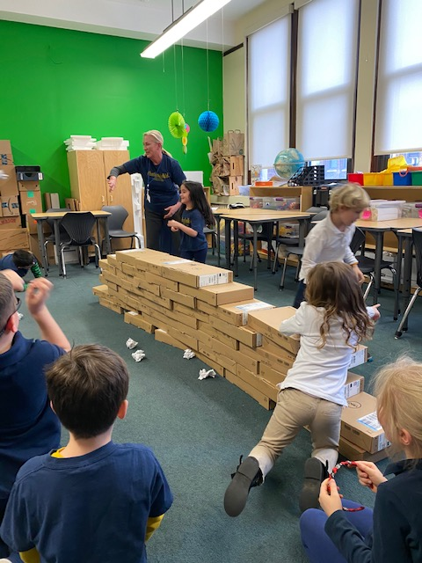
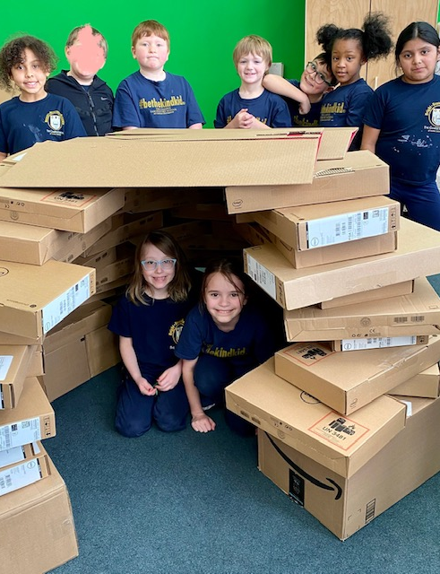
“Making”
winter

Slide 4
Meaningful Maker Spaces
Suzie Ament
Coordinator of Innovation and Learning

Slide 5
Laboratory school PK - 8
STEAM+ Curriculum since 2015
National Standards based Science, Arts and Mathematics
Engineering and Technology under development.

Slide 6
Develop a wide array of engaging, cross curricular experiences
Merge diverse standards into a captivating experience
Integrate new concepts into students’ existing understanding

Slide 7
Exploring Texture on Road Surfaces

Slide 8
Junk Wars

Slide 9
Historical Site Earthquake
Retrofit

Slide 10
Coordinate content and skill development to support:
practicing teachers
pre-service teachers
Campus Laboratory School students

Slide 11
Partnered with CMU CREATE Lab
Accessed new and exciting technologies
Embedded them into an elementary/middle curriculum

Slide 12
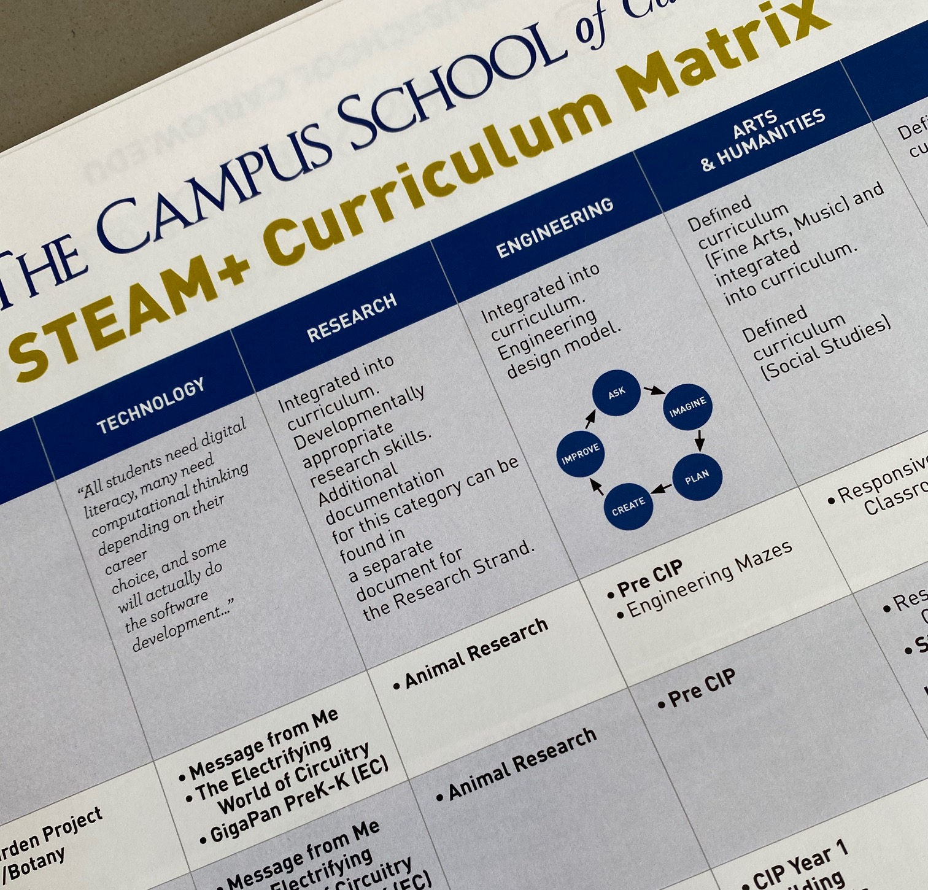

Slide 13
Our goals –
Improve our Technology and Engineering strands
Increase utilization of maker projects
Provide each department with Mobile Maker resources.

Slide 14
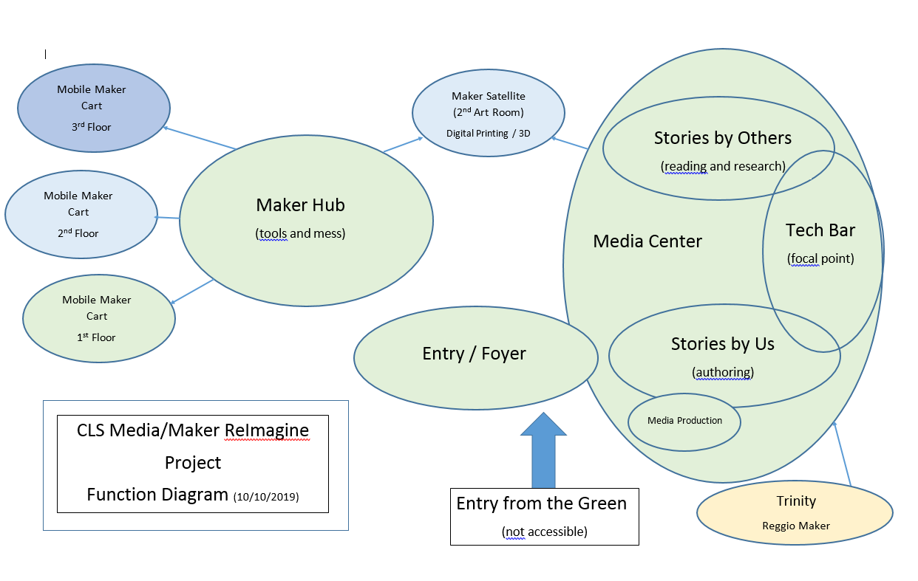

Slide 15
Augment Engineering and Technology strands:
Engage students who are not drawn to traditional school subjects
Provide an attractive entry point for their studies
Practice design thinking
Develop persistence in the face of challenge
Empower students to solve problems

Slide 16
Research suggests
Resources for “making” should be distributed throughout the students’ environment so that they provide a logical recourse for problem solving challenges.

Slide 17
Give feedback often to help students remake and reiterate content-specific products, processes and knowledge.

Slide 18
Encourage students to better the lives of their peers, school and community.

Slide 19
Play multiple roles: engaged co-creator, mentor, problem-solver, activist or networker who brings the right people and tools together.

Slide 20
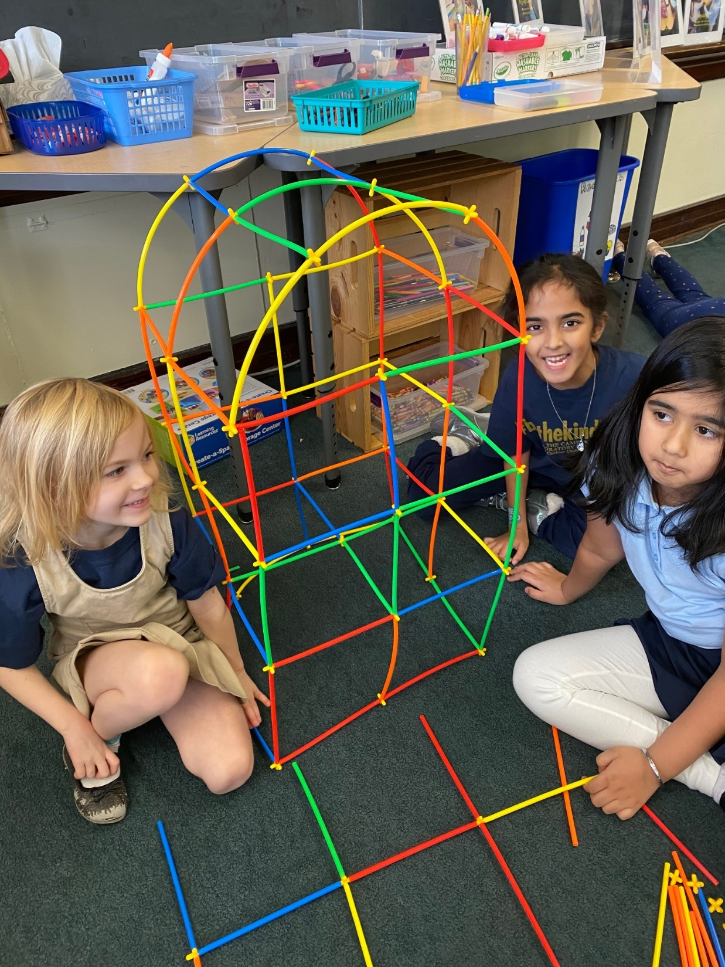
Work
cooperatively

Slide 21
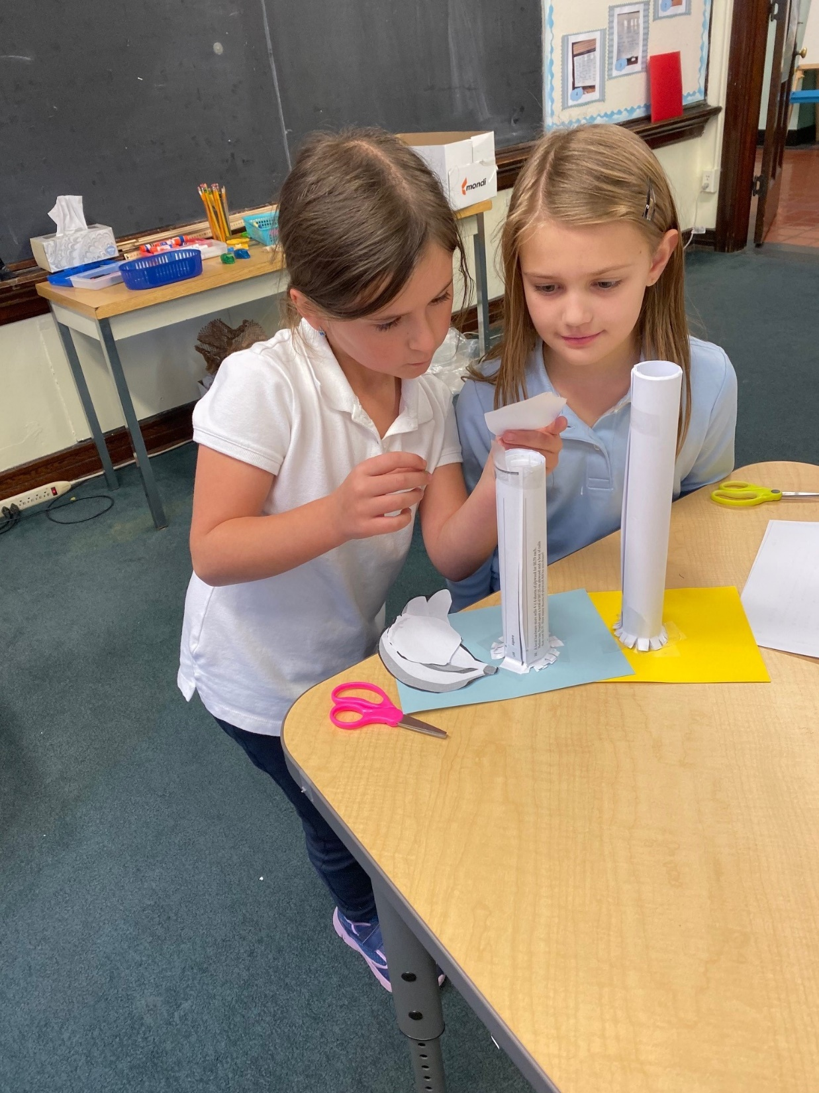
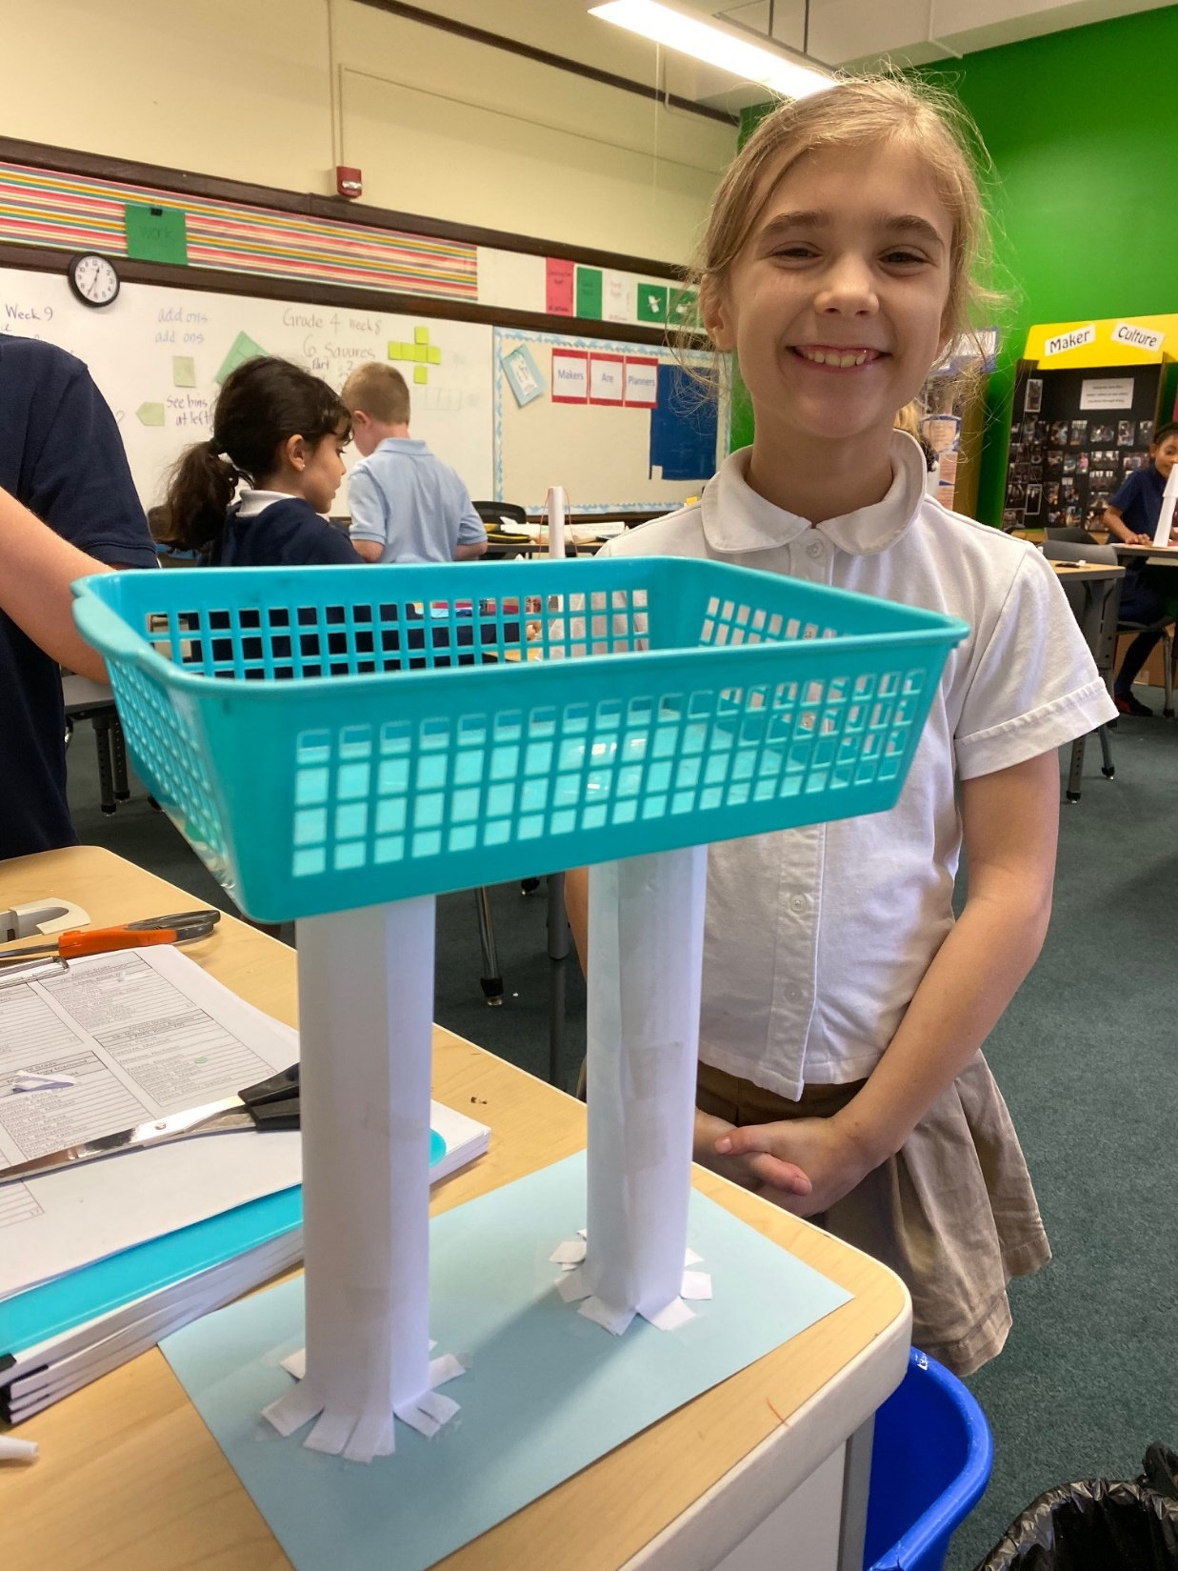
Persist in the face of a challenge

Slide 22
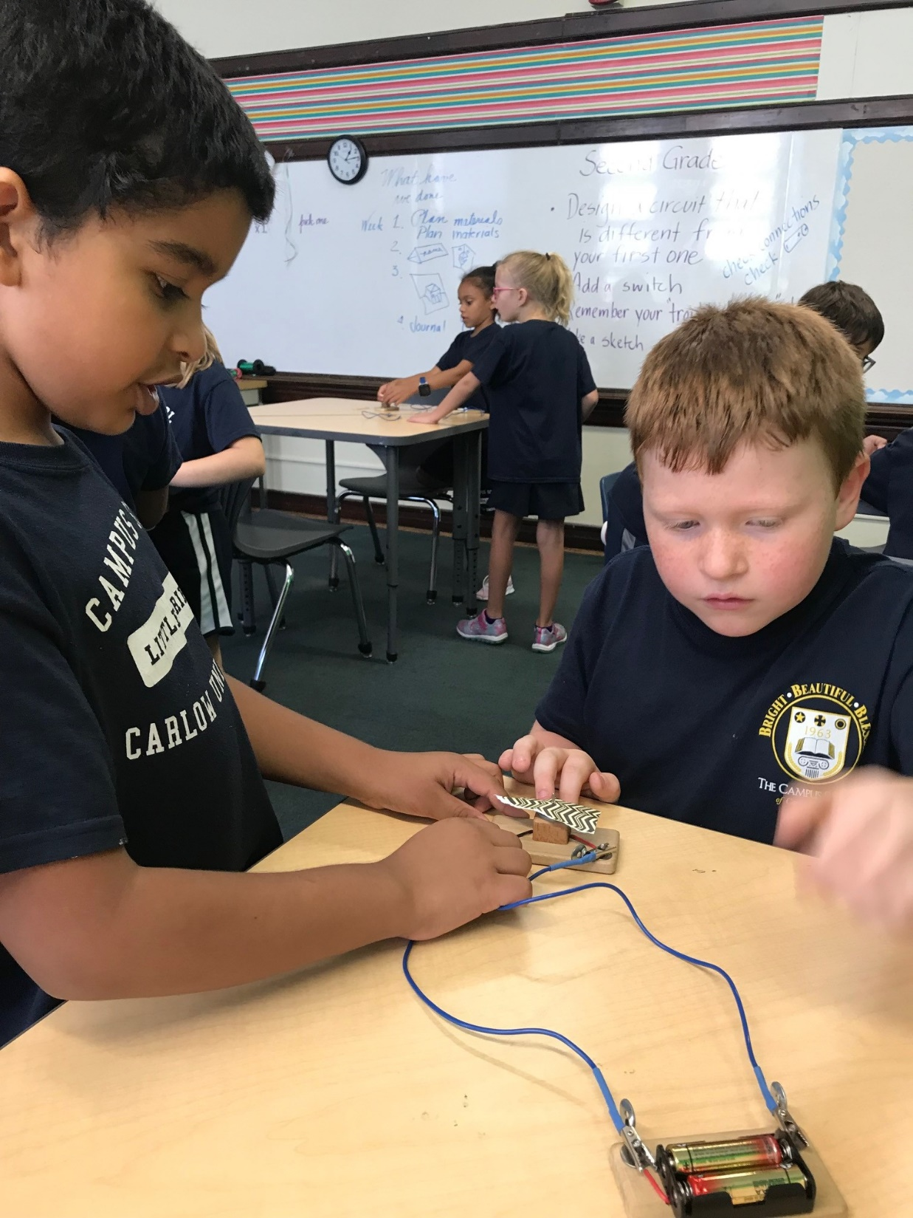
Build on
experience

Slide 23
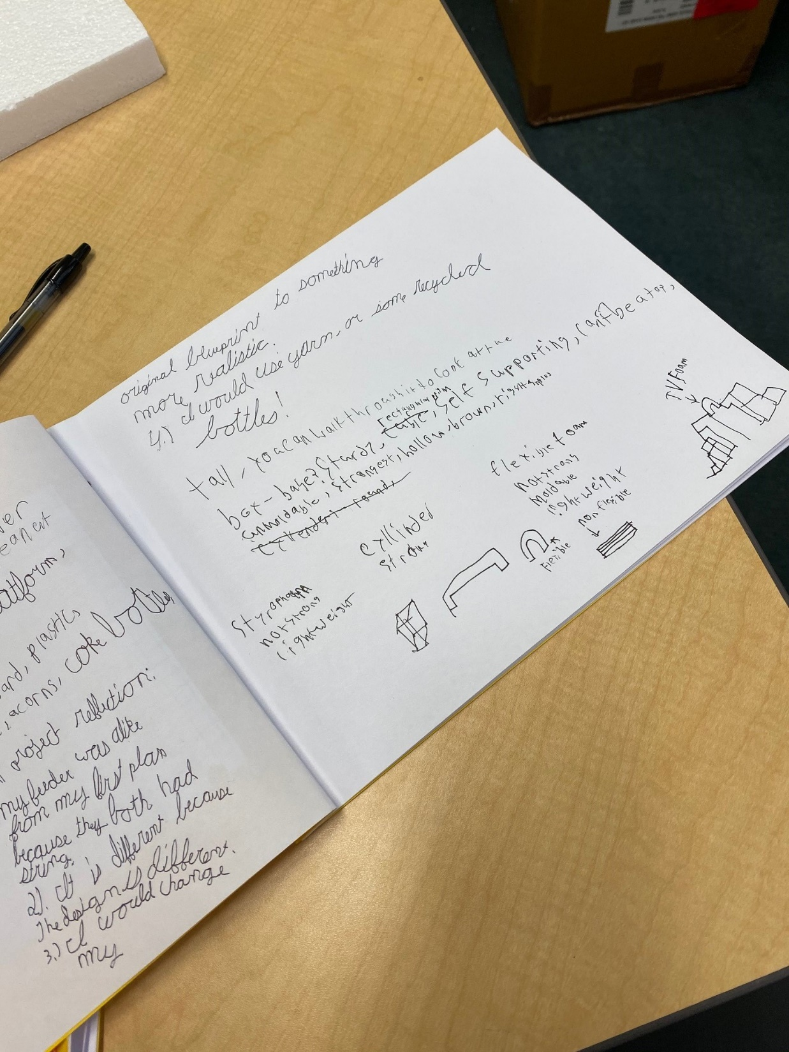
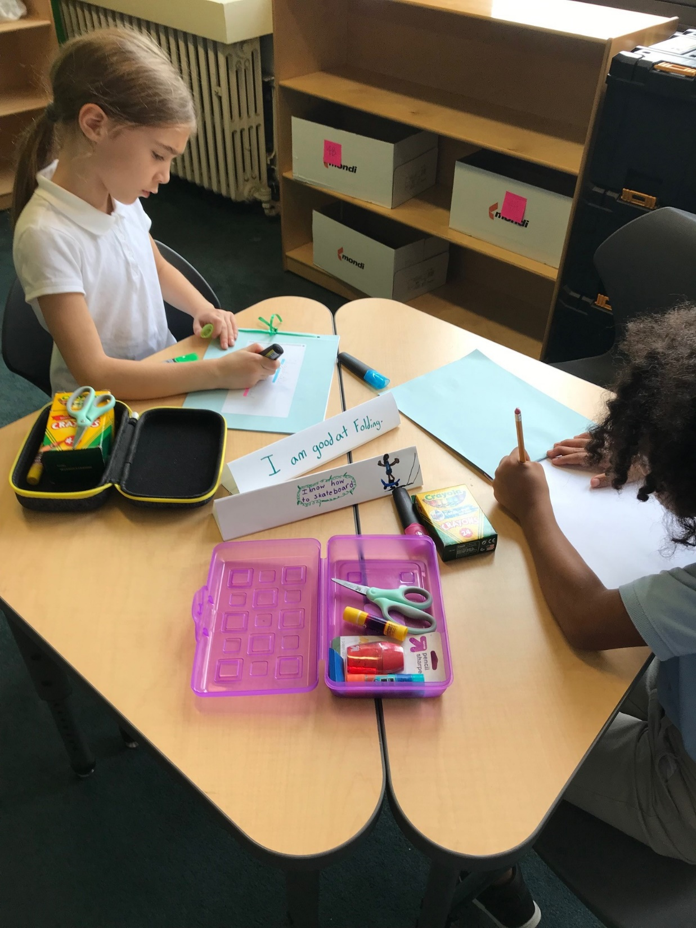
Support curriculum:
Literacy Skills

Slide 24
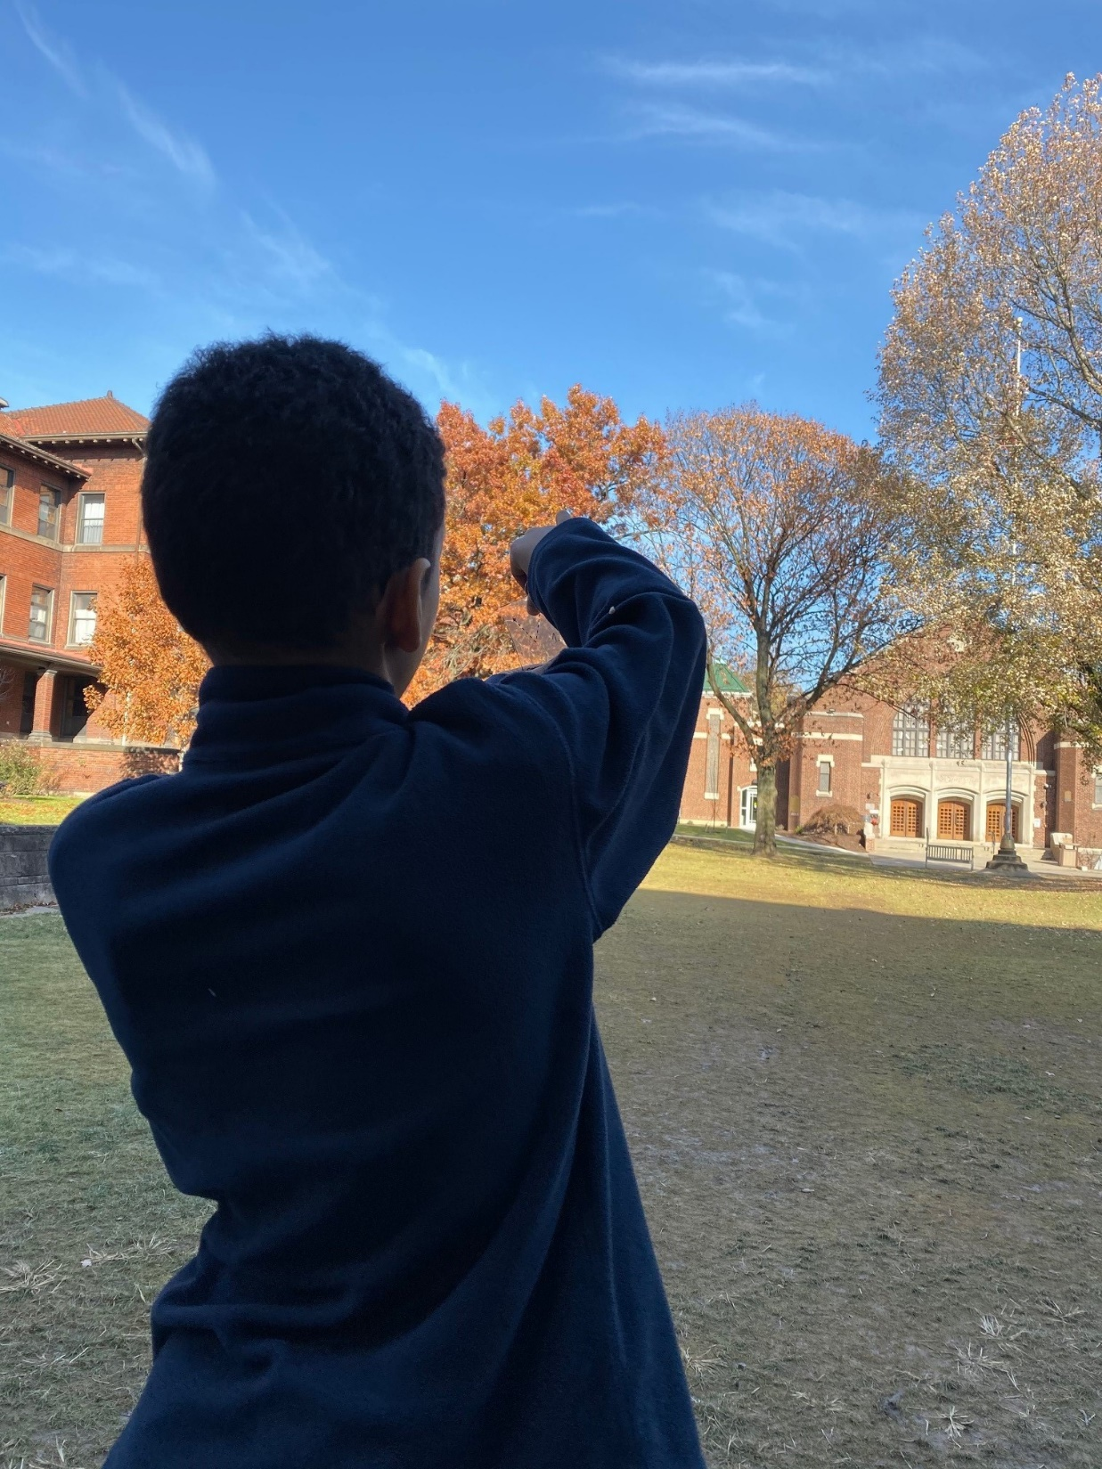
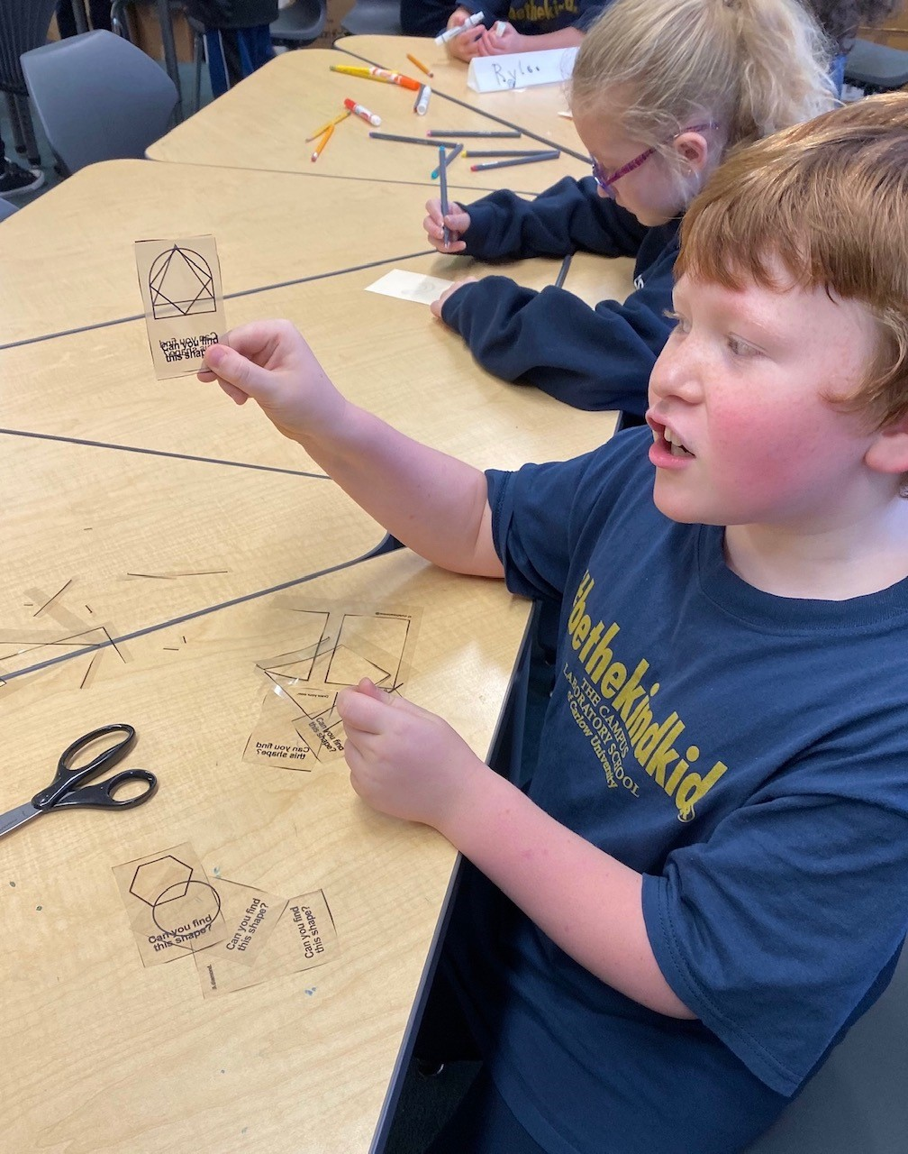
Support
Curriculum:
Shape & Angle Finder

Slide 25
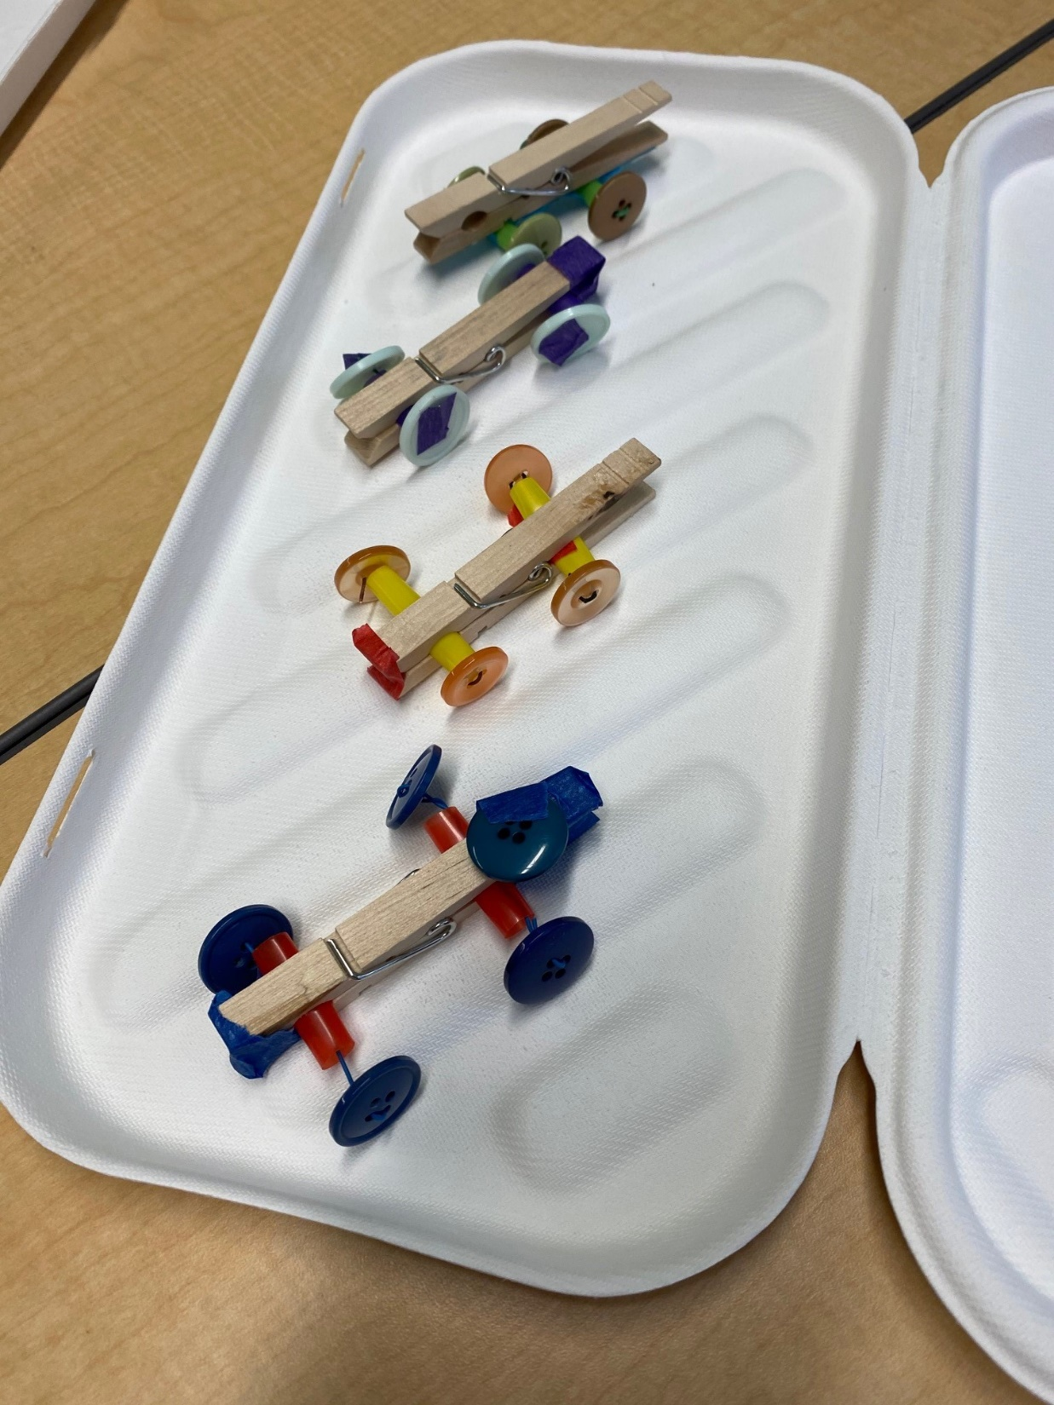
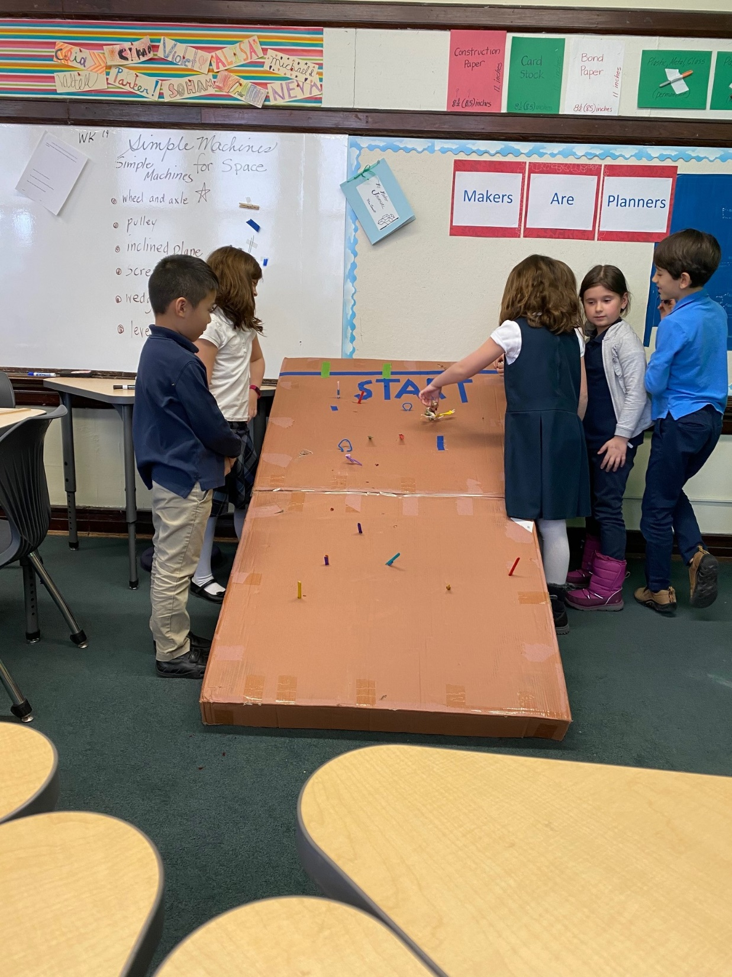
Support
Curriculum:
Simple Machines

Slide 26
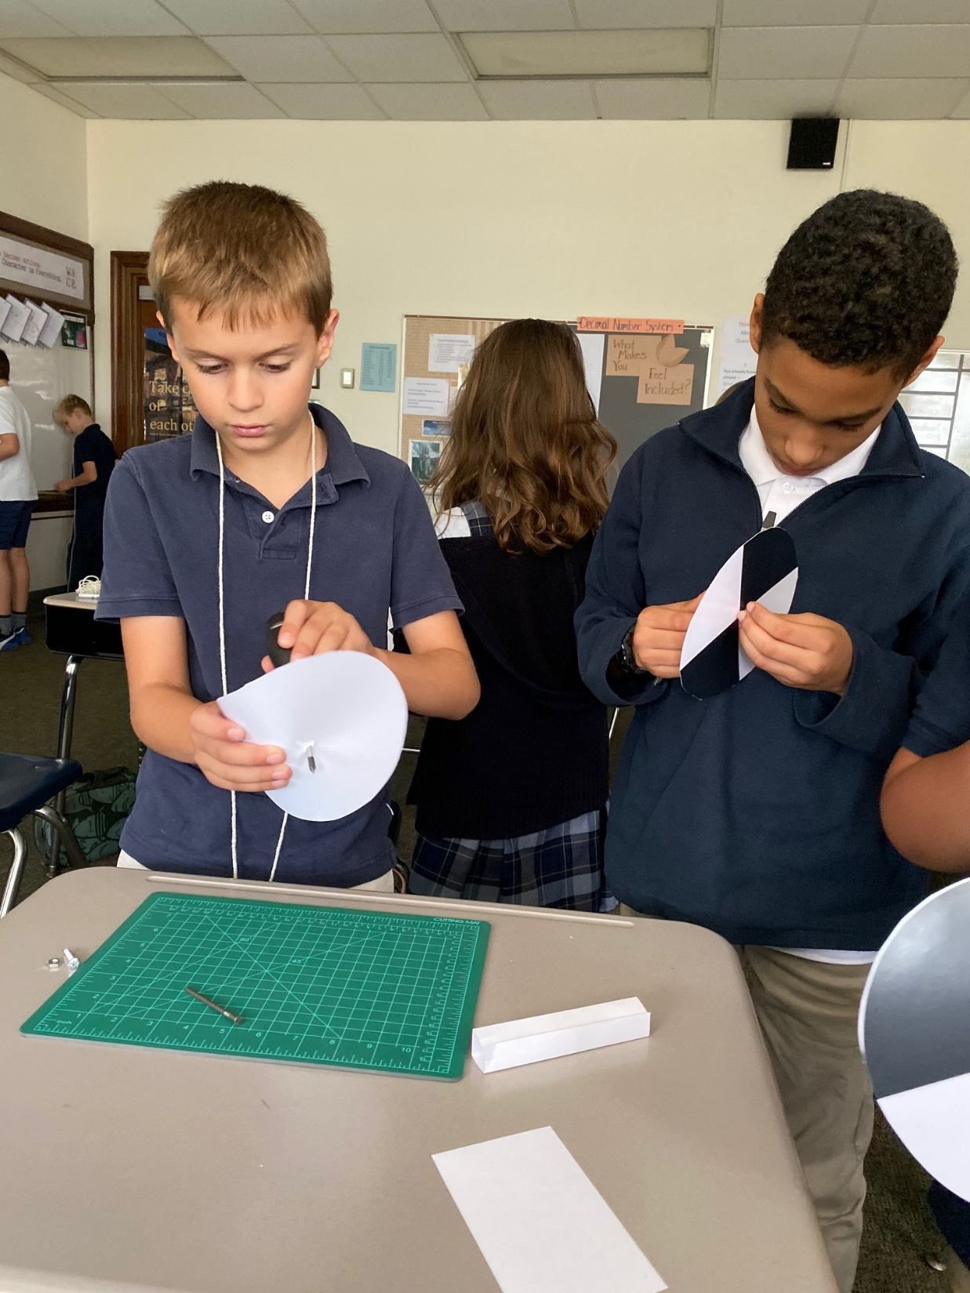
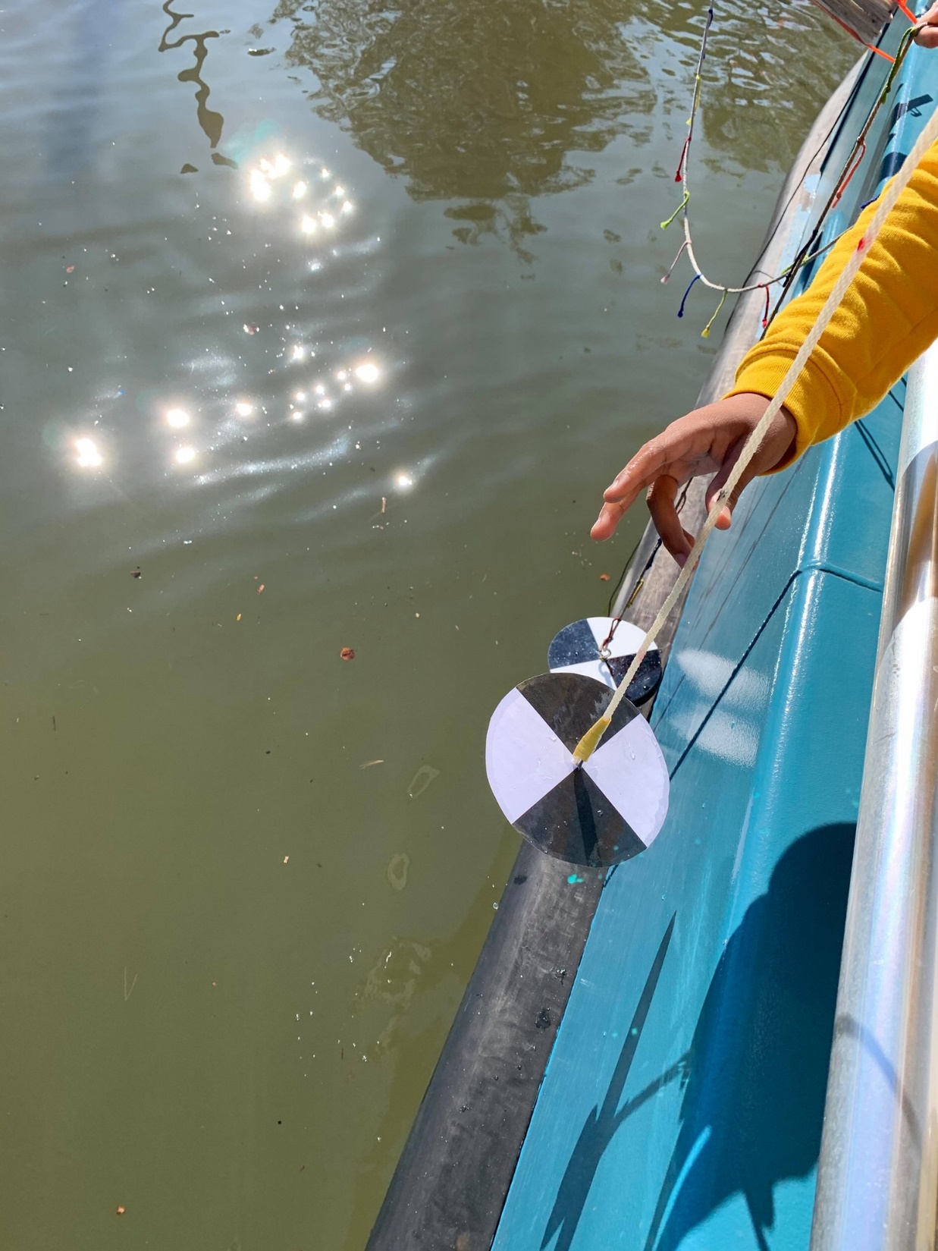
Support
Curriculum:
Water Quality

Slide 27
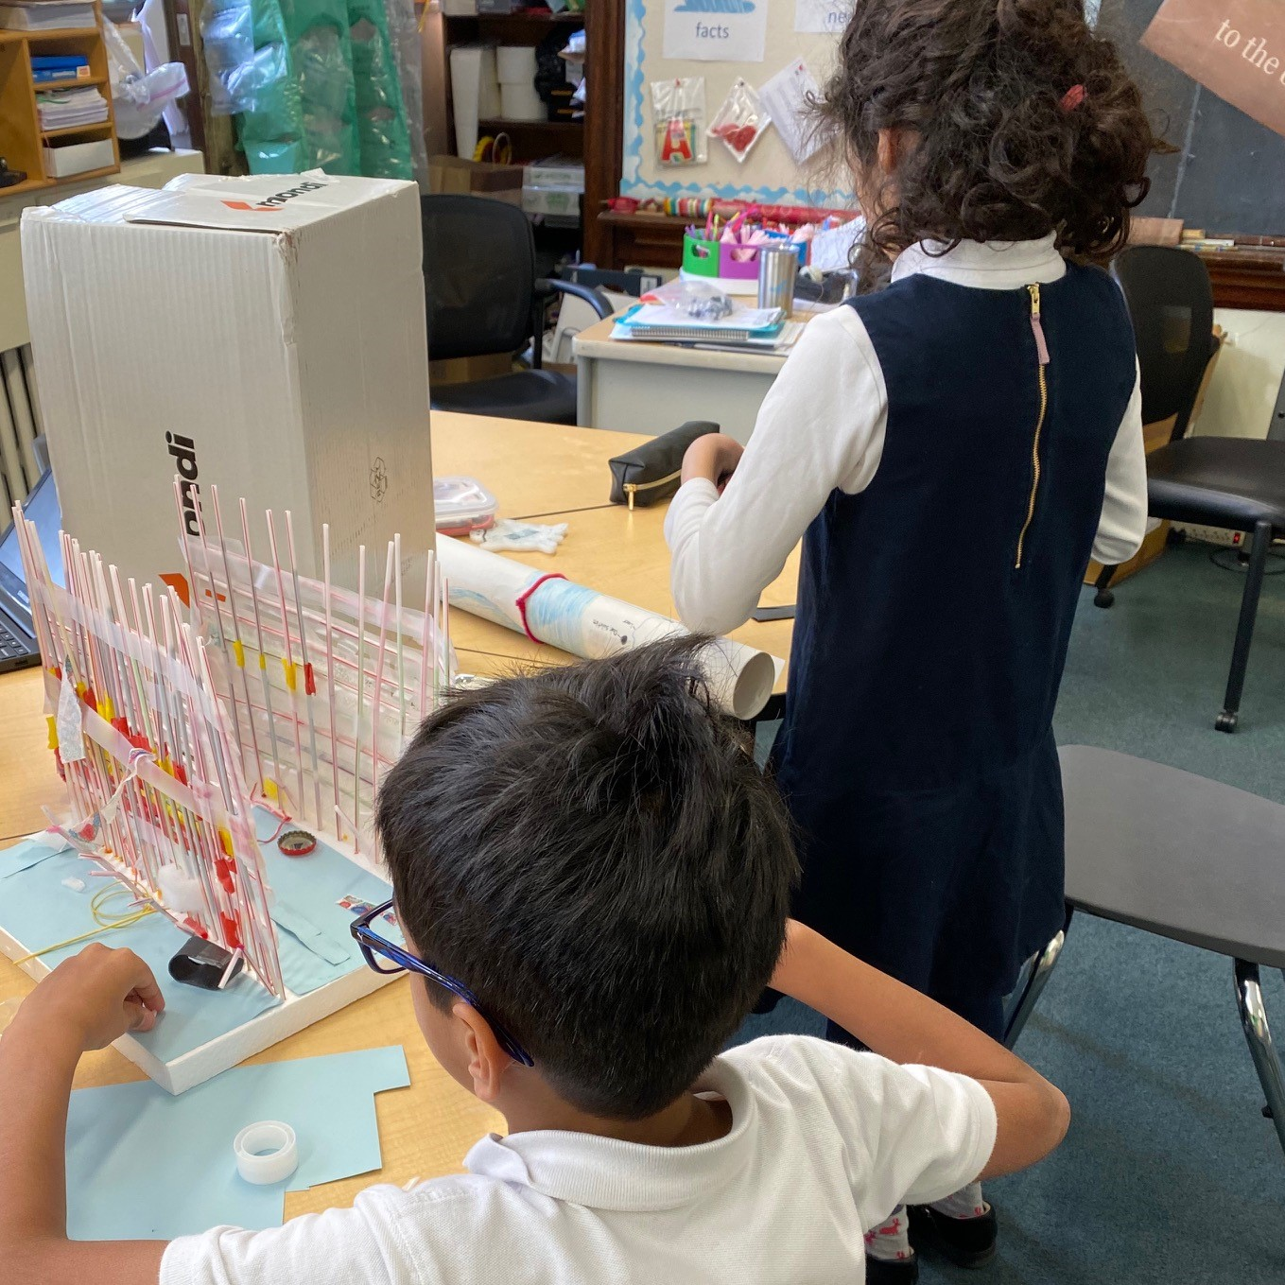
Support
Curriculum:
Clean Water Challenge

Slide 28
Exploring Dimensions

Slide 29
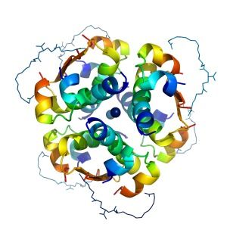

Slide 30
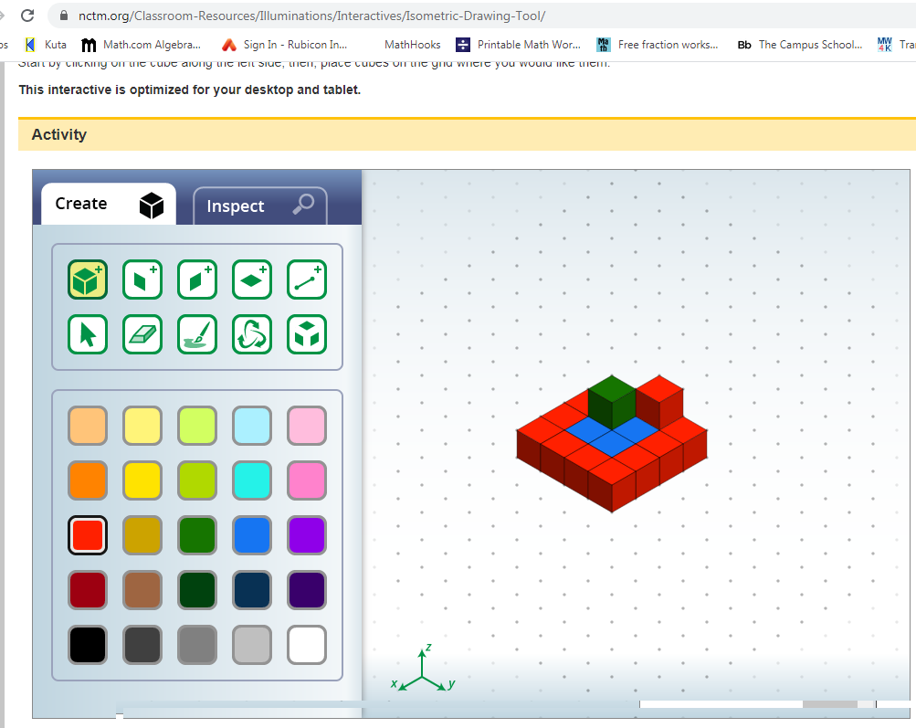
CAD tool with
3-axis rotation

Slide 31
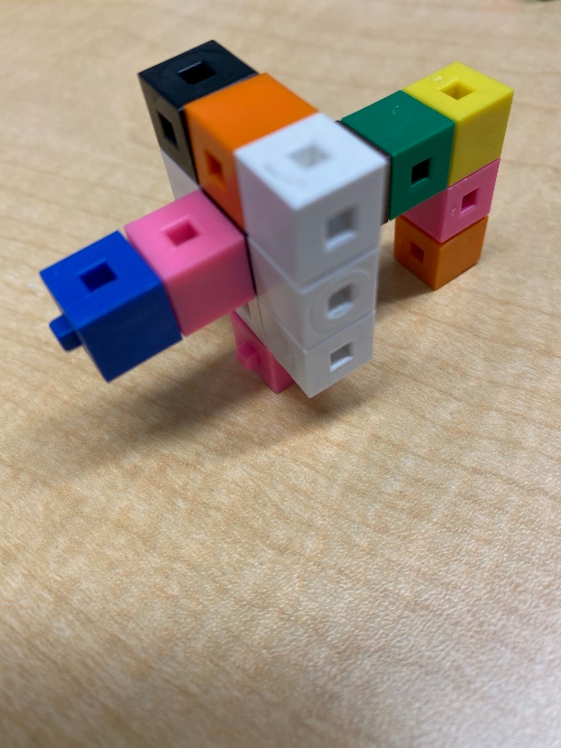
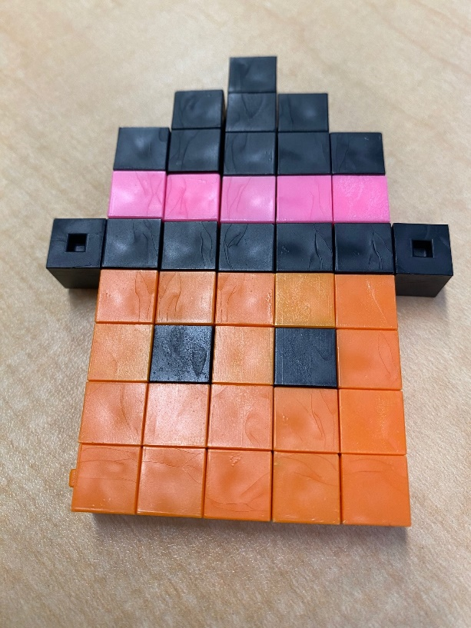
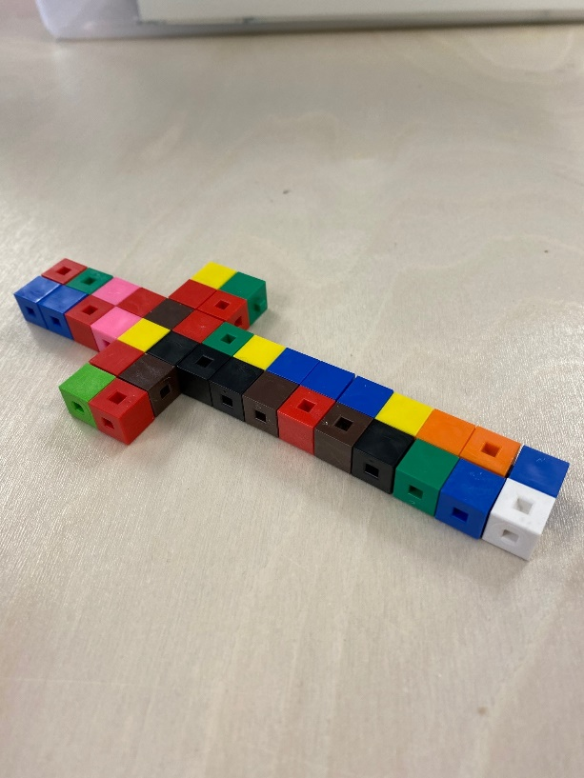
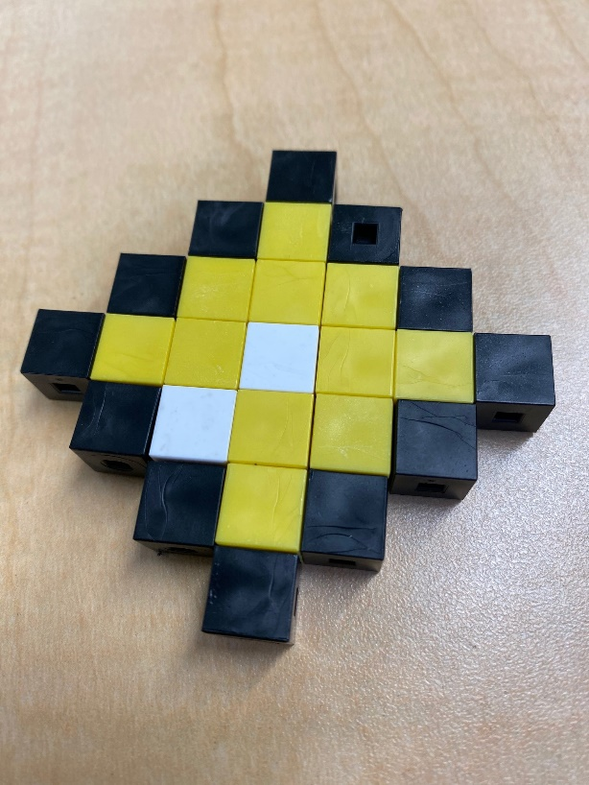
Centimeter cubes for creating models

Slide 32
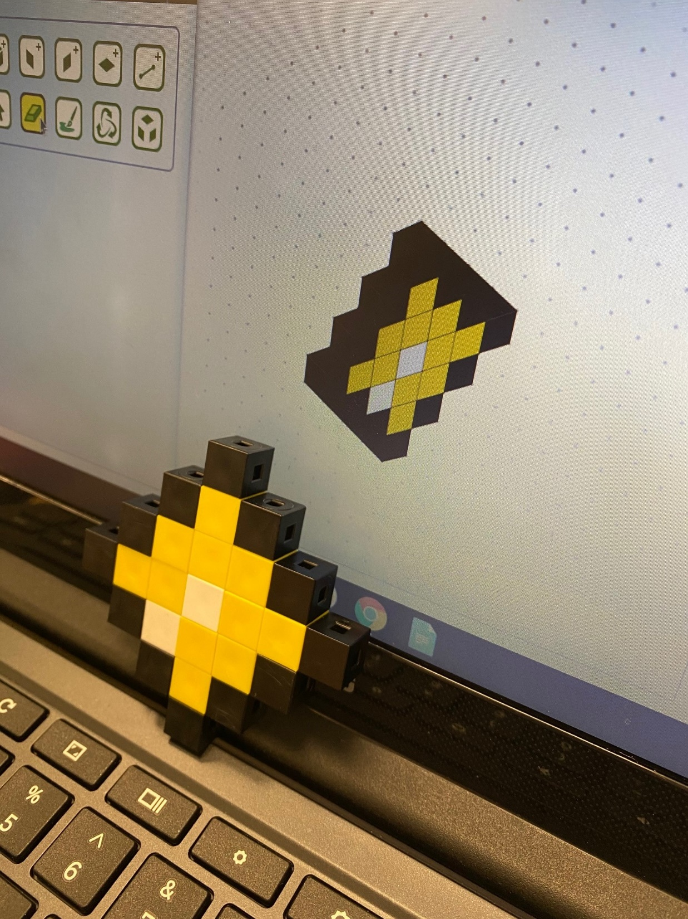
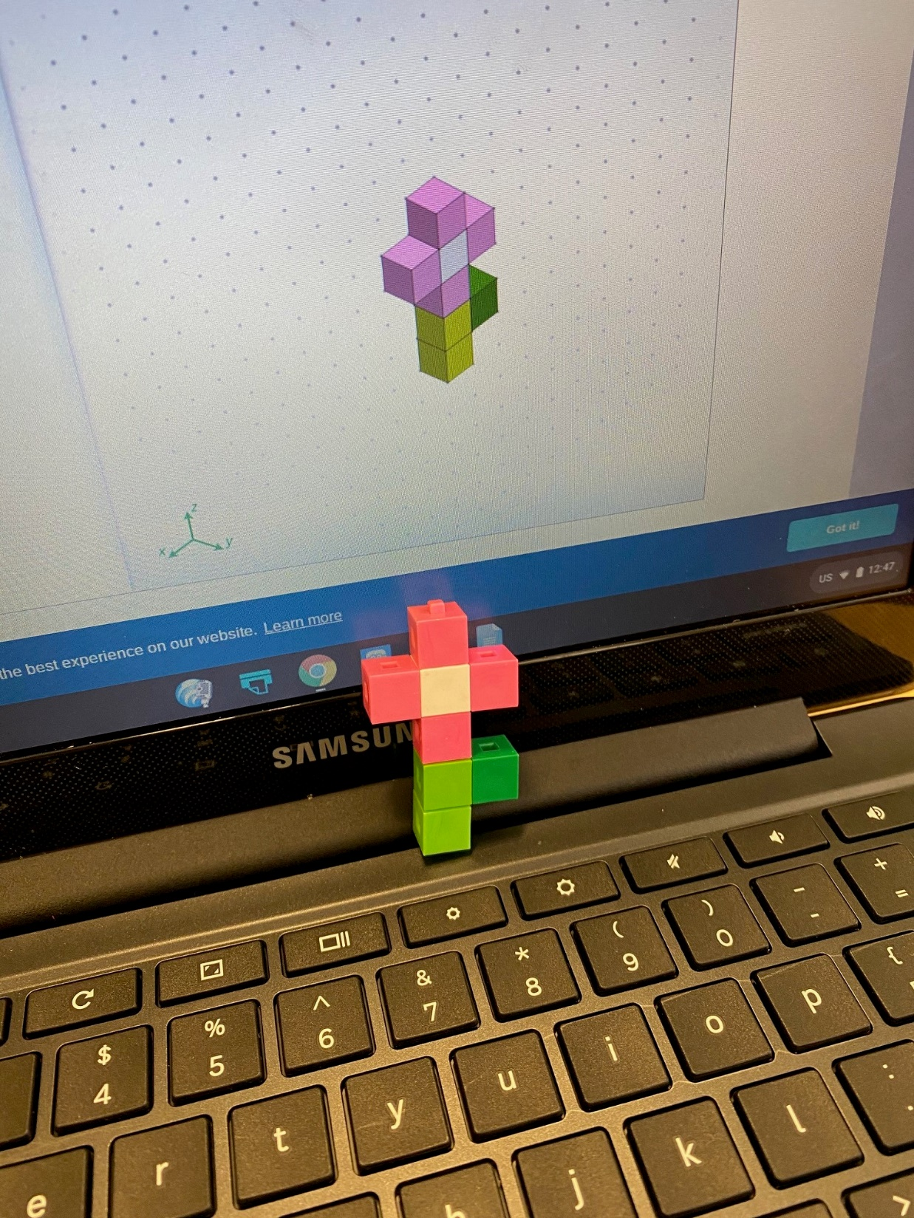
CAD tool modeling
construction

Slide 33
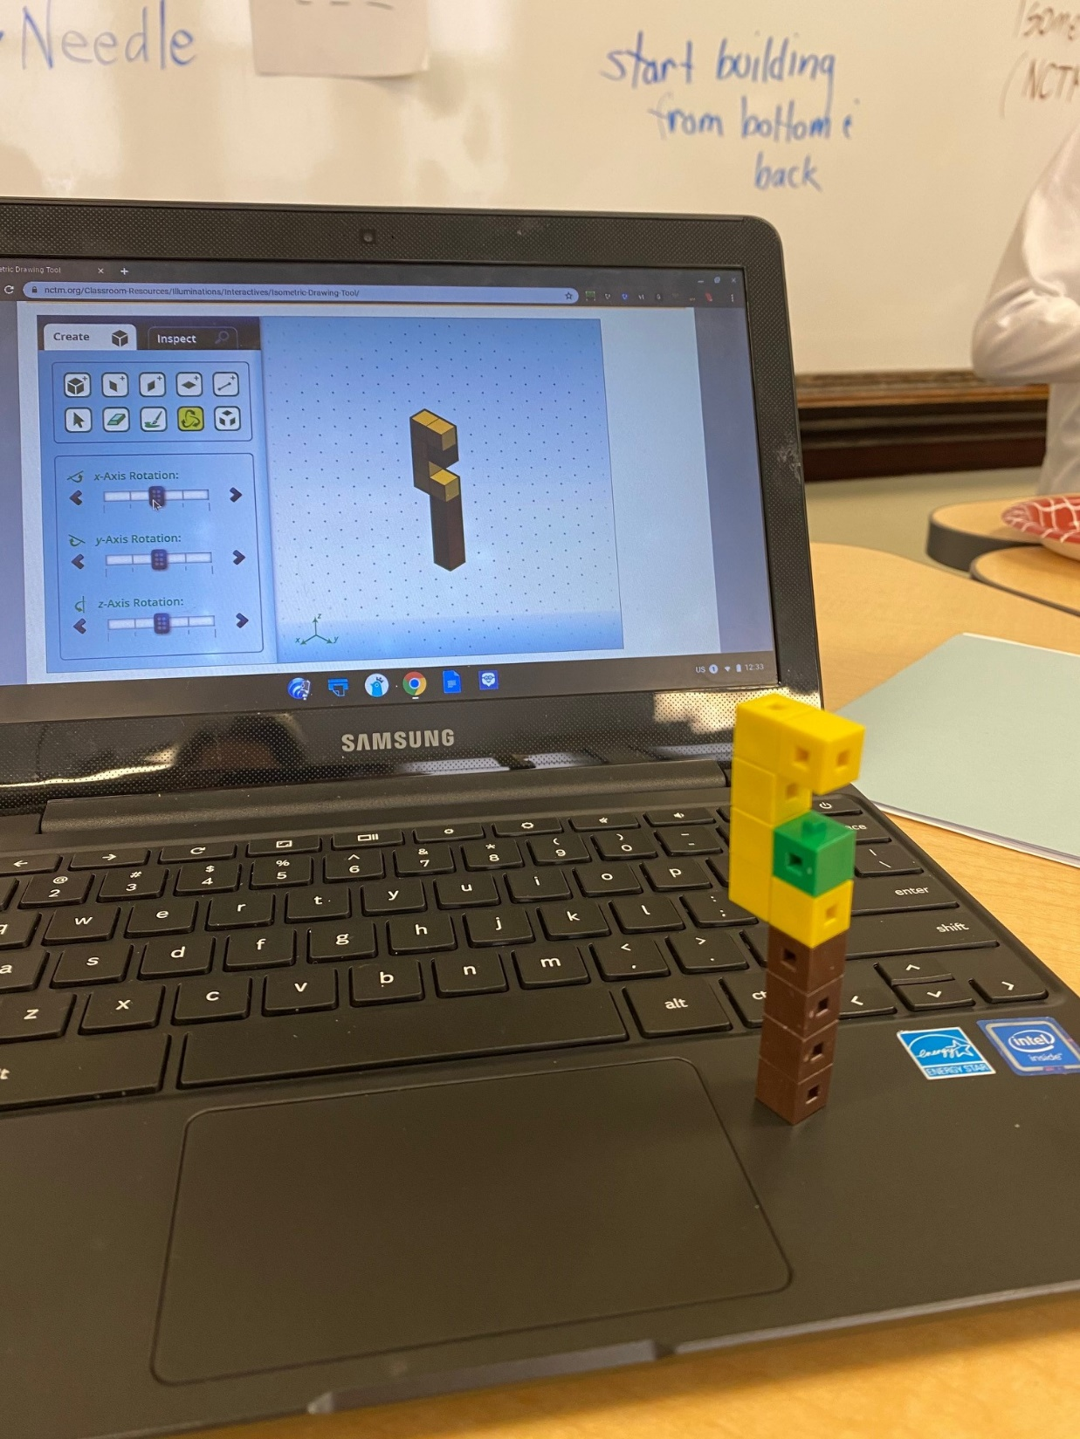
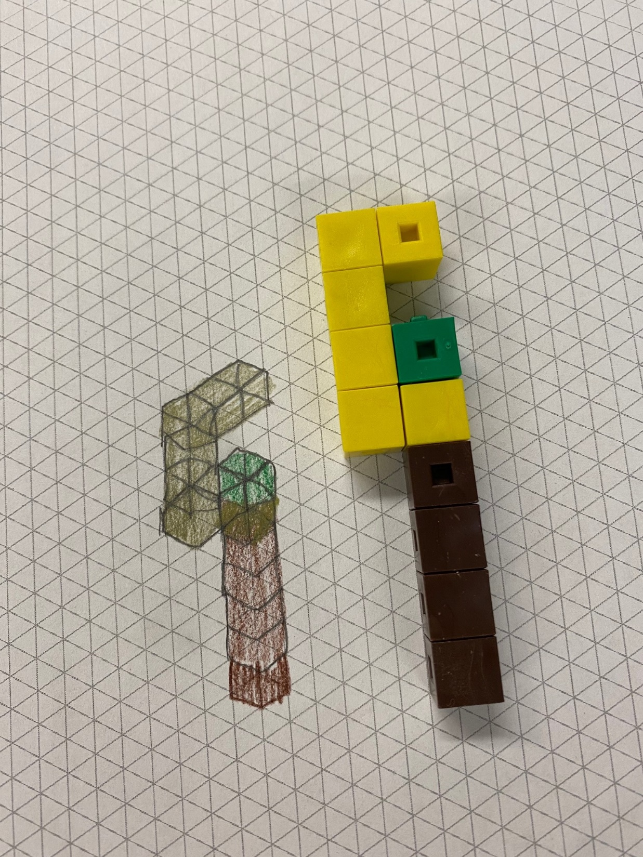
Isometric grid paper

Slide 34
Current Resources
Consumable
Drawing tools
Tapes
Fastening materials
Craft materials
String, yarn, ribbon
Papers
Building sets
Polydrons
Brain Flakes
Magnetic sets
Straw and connector
Cartons
Tools
Hole and cardboard punches
Canary knives
Scissors and cardboard scissors
Recycle materials
Cardboard
Plastics
Fabric
Oddities

Slide 35
A Pet Project

Slide 36
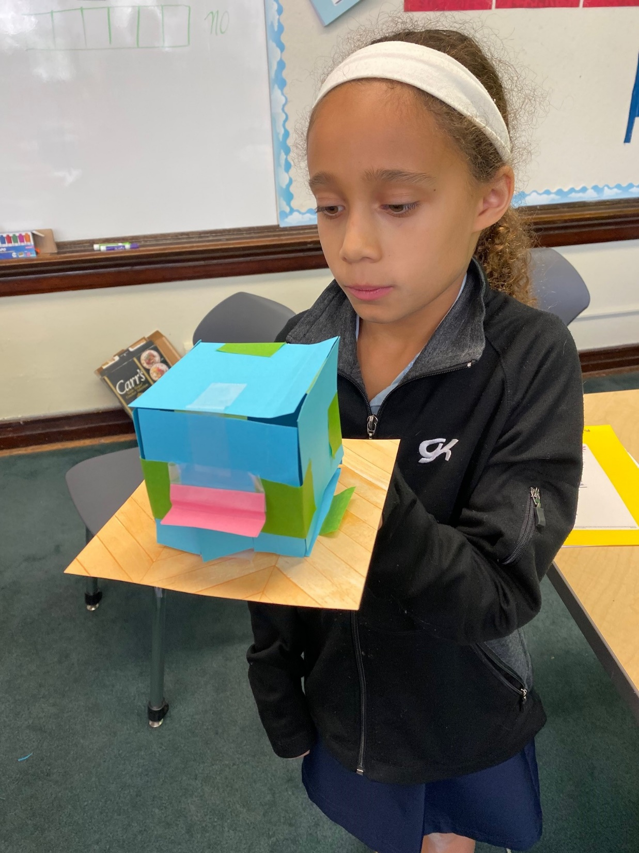
Six squares

Slide 37
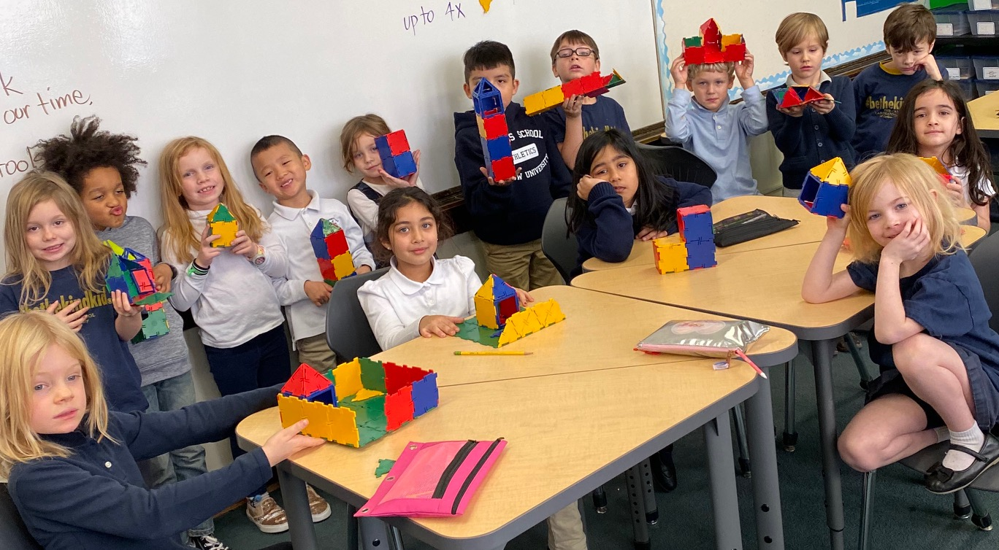
Design a pet shelter

Slide 38
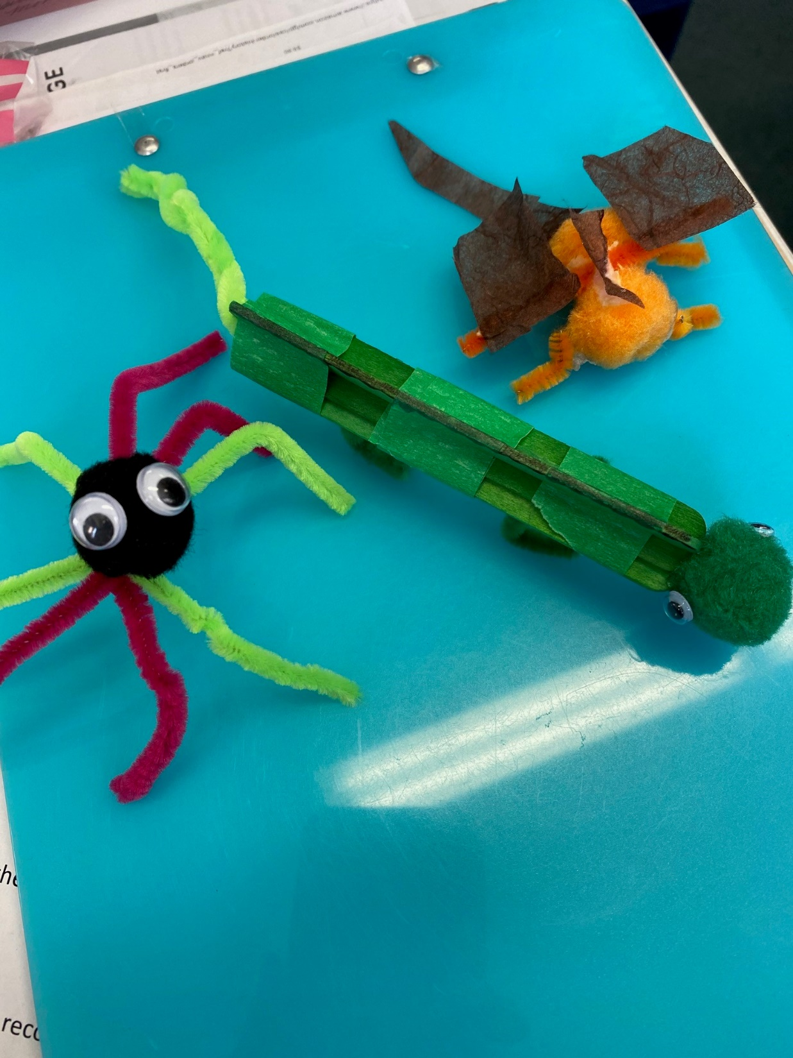
Create a pet
to fit its home

Slide 39
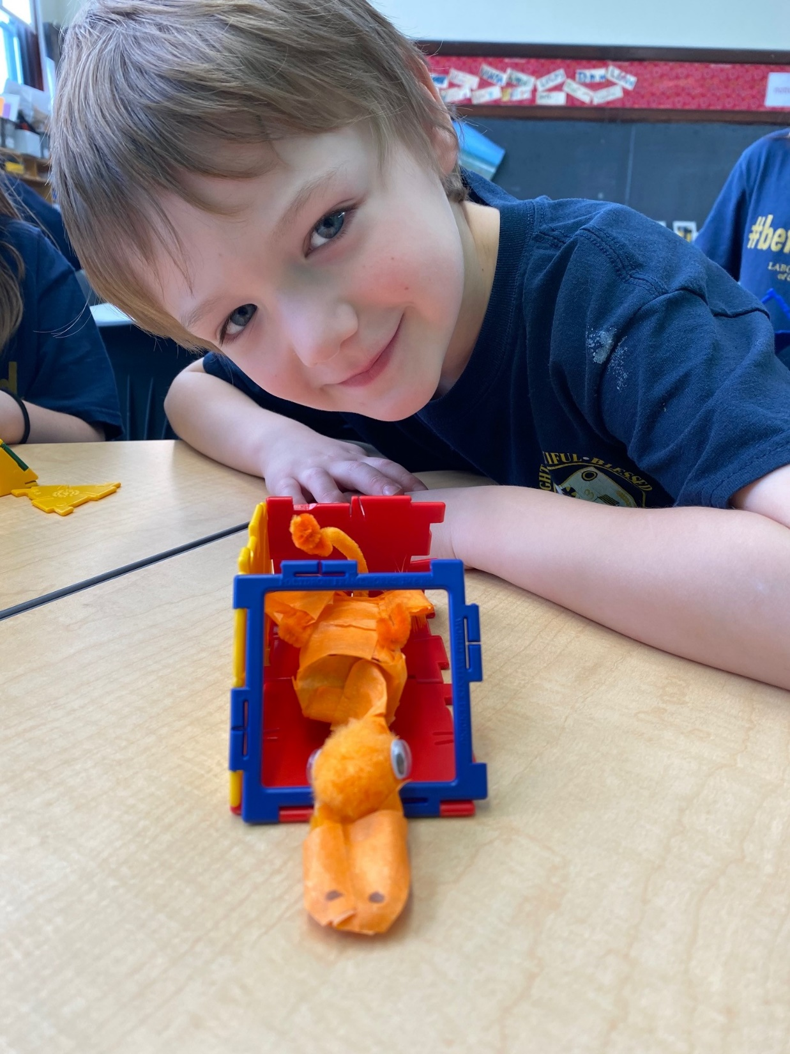
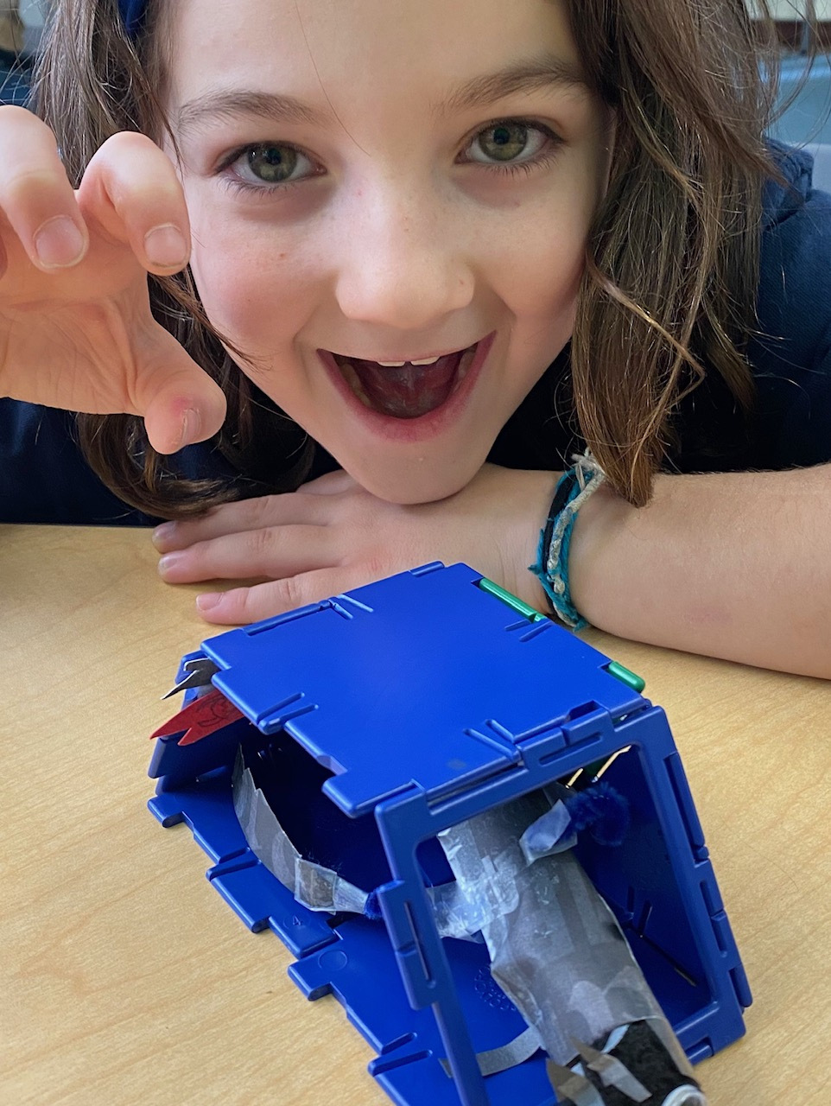
Pet
“Move-in” Day

Slide 40
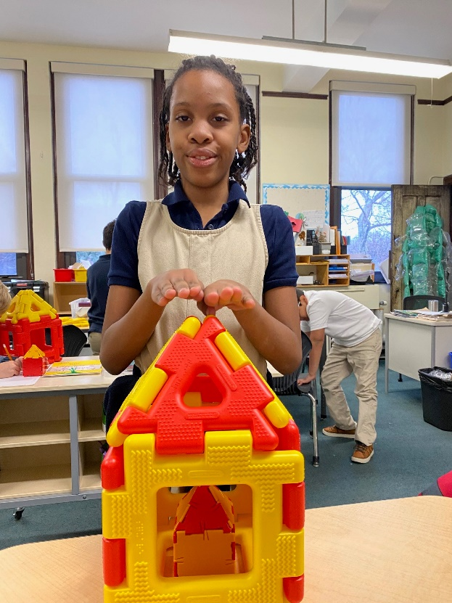
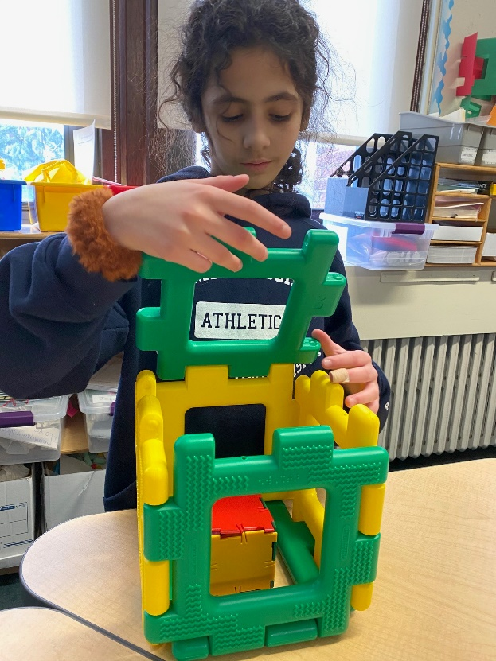
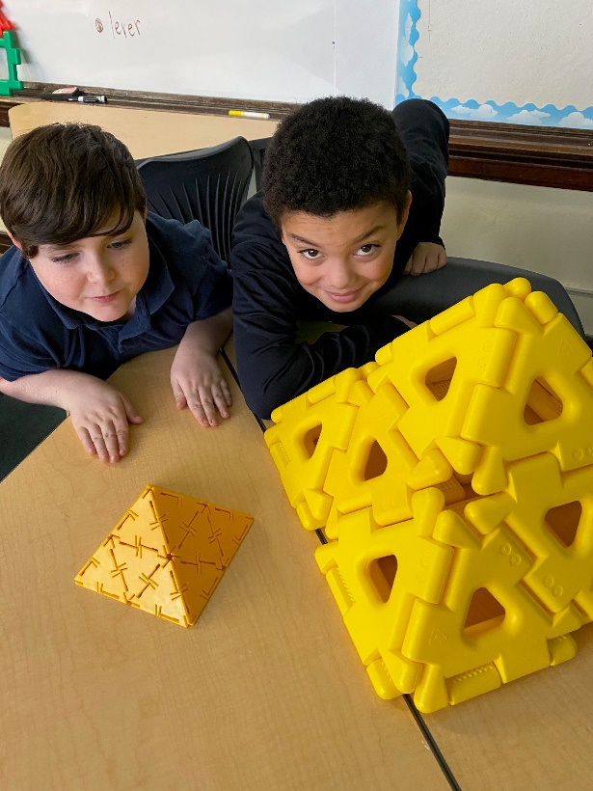
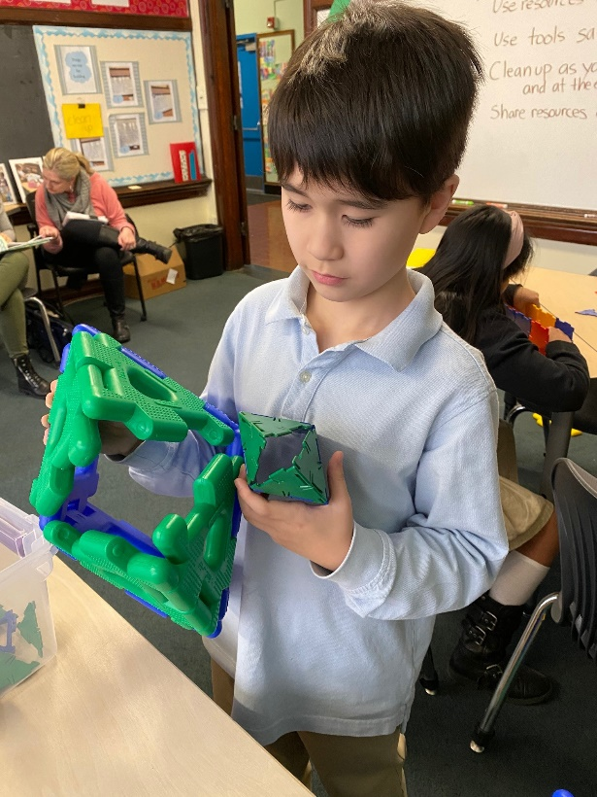
Build a scaled model

Slide 41
Works Cited
Integrating Makerspaces Throughout the Curriculum https://thejournal.com/articles/2018/09/04/integrating-makerspaces-throughout-the-curriculum.aspx
ReMaking Education: Designing Classroom Makerspaces for Transformative Learning https://www.edutopia.org/blog/classroom-makerspaces-transformative-learning-stephanie-west-puckett
Why the “A” in STEAM Education is Just As Important As Every Other Letter https://education.cu-portland.edu/blog/leaders-link/importance-of-arts-in-steam-education/?fbclid=IwAR0NG-Age7AzTV8AM8v8psg_qQdEGzltzH0f9cCcbC911Xc6xpVe-k_Md-8

